Slide 1
Peripheral Devices
Devices that are under the direct control of the computer are said to be connected on-line. These devices are designed to read information into or out of the memory unit upon command from the CPU and are considered to be part of the total computer system. Input or output devices attached to the computer are also called peripherals. Among the most common peripherals are keyboards, display units, and printers. Peripherals that provide auxiliary storage for the system are magnetic disks and tapes.

Slide 2
Monitor & Keyboard
Video monitors are the most commonly used peripherals. They consist of a keyboard as the input device and a display unit as the output device.
There are different types of video monitors, but the most popular use a cathode ray tube (CRT). The CRT contains an electronic gun that sends an electronic beam to a phosphorescent screen in front of the tube.
The beam can be deflected horizontally and vertically. To produce a pattern on the screen, a grid inside the CRT receives a variable voltage that causes the beam to hit the screen and make it glow at selected spots.
Horizontal and vertical signals deflect the beam and make it sweep across the tube, causing the visual pattern to appear on the screen. A characteristic feature of display devices is a cursor that marks the position in the screen where the next character will be inserted.
The cursor can be moved to any position in the screen, to a single character, the beginning of a word, or to any line. Edit keys add or delete information based on the cursor position. The display terminal can operate in a single-character mode where all characters entered on the screen through the keyboard are transmitted to the computer simultaneously.

Slide 3
Printer
Printers provide a permanent record on paper of computer output data or text.
There are three basic types of character printers: daisywheel, dot matrix, and laser printers.
The daisywheel printer contains a wheel with the characters placed along the circumference. To print a character, the wheel rotates to the proper position and an energized magnet then presses the letter against the ribbon.
The dot matrix printer contains a set of dots along the printing mechanism. For example, a 5 x 7 dot matrix printer that prints 80 characters per line has seven horizontal lines, each consisting of 5 x 80 = 400 dots. Each dot can be printed or not, depending on the specific characters that are printed on the line.
The laser printer uses a rotating photographic drum that is used to imprint the character images. The pattern is then transferred onto paper in the same manner as a copying machine.

Slide 4
Magnetic tape & Magnetic disk
Magnetic tapes are used mostly for storing files of data: for example, a company's payroll record. Access is sequential and consists of records that can be accessed one after another as the tape moves along a stationary read-write mechanism. It is one of the cheapest and slowest methods for storage and has the advantage that tapes can be removed when not in use.
Magnetic disks have high-speed rotational surfaces coated with magnetic material. Access is achieved by moving a read-write mechanism to a track in the magnetized surface. Disks are used mostly for bulk storage of programs and data.

Slide 5
I/O Interface
Input-output interface provides a method for transferring information between internal storage and external I/0 devices. Peripherals connected to a computer need special communication links for interfacing them with the central processing unit. The purpose of the communication link is to resolve the differences that exist between the central computer and each peripheral.
The major differences are:
1. Peripherals are electromechanical and electromagnetic devices and their manner of operation is different from the operation of the CPU and memory, which are electronic devices. Therefore, a conversion of signal values may be required.
2. The data transfer rate of peripherals is usually slower than the transfer rate of the CPU, and consequently, a synchronization mechanism may be needed.
3. Data codes and formats in peripherals differ from the word format in the CPU and memory.
4. The operating modes of peripherals are different from each other and each must be controlled so as not to disturb the operation of other peripherals connected to the CPU.
To resolve these differences, computer systems include special hardware components between the CPU and peripherals to supervise and synchronize all input and output transfers. These components are called interface units because they interface between the processor bus and the peripheral device

Slide 6
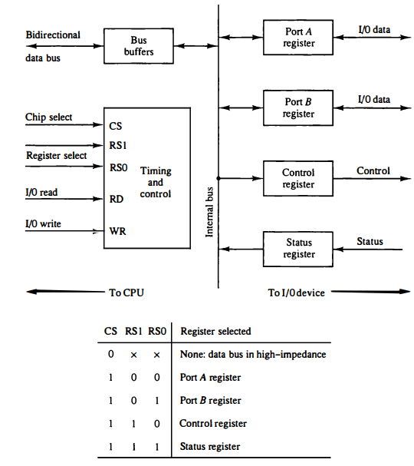
Example of I/O Interface
An example of an l/0 interface unit is shown in block diagram. It consists of two data registers called ports, a control register, a status register, bus buffers, and timing and control circuits. The interface communicates with the CPU through the data bus. The chip select and register select inputs determine the address assigned to the interface. The l/0 read and write are two control lines that specify an input or output, respectively. The four registers communicate directly with the l/0 device attached to the interface.
Example of I/O Interface unit

Slide 7
The l/0 data to and from the device can be transferred into either port A or port B. The interface may operate with an output device or with an input device, or with a device that requires both input and output.
If the interface is connected to a printer, it will only output data, and if it services a character reader, it will only input data.
The control register receives control information from the CPU. By loading appropriate bits into the control register, the interface and the l/0 device attached to it can be placed in a variety of operating modes. For example, port A may be defined as an input port and port B as an output port. A magnetic tape unit may be instructed to rewind the tape or to start the tape moving in the forward direction.
The bits in the status register are used for status conditions and for recording errors that may occur during the data transfer. For example, a status bit may indicate that port A has received a new data item from the 110 device. Another bit in the status register may indicate that a parity error has occurred during the transfer.

Slide 8
Asynchronous Data Transfer
The internal operations in a digital system are synchronized by means of clock pulses supplied by a common pulse generator.
Clock pulses are applied to all registers within a unit and all data transfers among internal registers occur simultaneously during the occurrence of a clock pulse.
Two units, such as a CPU and an IO interface, are designed independently of each other. If the registers in the interface share a common clock with the CPU registers, the transfer between the two units is said to be synchronous.
In most cases, the internal timing in each unit is independent from the other in that each uses its own private clock for internal registers.
In that case, the two units are said to be asynchronous to each other. This approach is widely used in most computer systems.

Slide 9
Asynchronous Data Transfer Techniques
Asynchronous data transfer between two independent units requires that control signals be transmitted between the communicating units to indicate the time at which data is being transmitted.
1. Strobe Control: One way of achieving this is by means of a strobe pulse supplied by one of the units to indicate to the other unit when the transfer has to occur.
2. Handshaking: Another method commonly used is to accompany each data item being transferred with a control signal that indicates the presence of data in the bus. The unit receiving the data item responds with another control signal to acknowledge receipt of the data. This type of agreement between two independent units is referred to as handshaking.

Slide 10
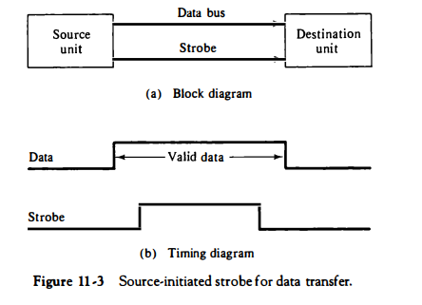
Strobe Control: The strobe control method of asynchronous data transfer employs a single control line to time each transfer. The strobe may be activated by either the source or the destination unit.
Figure 11-3(a) shows a source-initiated transfer The data bus carries the binary information from source unit to the destination unit. Typically, the bus has multiple lines to transfer an entire byte or word. The strobe is a single line that informs the destination unit when a valid data word is available in the bus.
As shown in the timing diagram of Fig. 11-3(b), the source unit first places the data on the data bus. After a brief delay to ensure that the data settle to a steady value, the source activates the strobe pulse. The information on the data bus and the strobe signal remain in the active state for a sufficient time period to allow the destination unit to receive the data. Often, the destination unit uses the falling edge of the strobe pulse to transfer the contents of the data bus into one of its internal registers. The source removes the data from the bus a brief period after it disables its strobe pulse. Actually, the source does not have to change the information in the data bus.

Slide 11
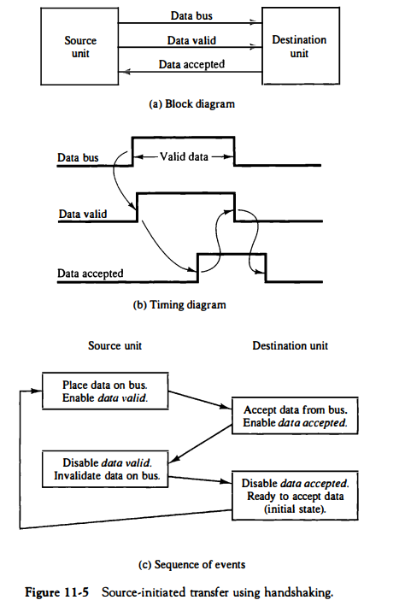
Handshaking: The disadvantage of the strobe method is that the source unit that initiates the transfer has no way of knowing whether the destination unit has actually received the data item that was placed in the bus.
Fig. shows the data transfer procedure when initiated by the source. The two handshaking lines are data valid, which is generated by the source unit, and data accepted, generated by the destination unit. The timing diagram shows the exchange of signals between the two units. The sequence of events listed in part (c) shows the four possible states that the system can be at any given time. The source unit initiates the transfer by placing the data on the bus and enabling its data valid signal. The data accepted signal is activated by the destination unit after it accepts the data from the bus. The source unit then disables its data valid signal, which invalidates the data on the bus. The destination unit then disables its data accepted signal and the system goes into its initial state. The source does not send the next data item until after the destination unit shows its readiness to accept new data by disabling its data accepted signal.

